Slide 1
Biofouling management requirements
SAL Policy Council
18 October 2023
Peter Wilkinson
Director Biofouling and In-water cleaning Animal Biosecurity
Pestsmarine@aff.gov.au

Slide 2
Australia’s biofouling requirements
Phased implementation
Implementation
Data gathering
Preparation for implementing Phase 2
‘Enforcement ready’
Mandatory pre-arrival reporting on biofouling management practices & in-water cleaning intentions
Misreporting
On-board verification of pre-arrival reports
Identify best practice
Department system upgrades
Templates and BFMP guidelines (ABFMR)
Update internal training and procedures
Enforcement in line with department compliance policy
Ongoing monitoring and advice
Plan future changes
Phase 1 - Education phase
Phase 2 – ‘Enforcement’
June 2022
Dec 2022
June 2023
Dec 2023
Notes:
Initially we were expecting a 12-month timeframe from receiving royal assent to the changes to the regulations coming into effect. We were only given 6 months. We couldn’t get all the changes we needed to MARS done in 6 months so we decided to deliver a minimum viable product to allow vessels to meet their new reporting obligations and then follow up with further updates down the line.
For Phase 1, it was decided we should capture data from a sample of all vessels entering Australia so questions were added to RVI and SSC eForms. The only difference for vessels that reported they hadn’t implemented an approved method was that they got fewer questions in the pre-arrival report. We also asked many questions about BFMPs (as the preferred option) so we could see if they had all the components that we thought they should have.
Inspectors were given a fairly basic elearning package and tasked with checking (in the case of BFMP) that they had the required components. If not, no action needed to be taken, education material could be provided. In cases where significant biofouling was noticed on the hull, they could escalate to my team for advice.
Since we delivering phase 1 in June 2022 we’ve been looking at the data we’ve been receiving and also collating feedback from inspectors, external stakeholders and industry peak bodies. All this information has gone into planning the changes for Phase 2.
We have been receiving a lot of enquiries from industry about our requirements which tells us that we need to do more comms as they’re often the same questions. We’re also seeing an increasing number of enquiries coming in from inspectors, which means we’re seeing good engagement in the issue but perhaps we haven’t provided enough training and guidance to our inspectors to empower them to make decisions when we enter phase 2. As a policy team, we’re not well equipped to deal with the volume of enquiries but we recognise that we’re the best placed to deal with them at this point – We’re going to address these issues while implementing phase 2.
To successfully deliver phase two (targeting for December 2023), we will be rolling out new training, including face-to-face (if we can get approval) so we can sit down with inspectors in the regions and go through a training package and look at example biofouling management plans to equip them with the skills to make a call on whether the plan meets our standard or not without needing to refer to us. We’re planning that the eForms will be simplified to a single question on the BFMP, rather than popping out multiple other questions. We’ll be publishing a new version of the Australian Biofouling Management Requirements which will include a BFMP template/example.
We were planning to make changes to MARS which would introduce some automated outcomes based on the PAR and eForm answers, but unfortunately changes to budget circumstances mean this isn’t going to be possible. For now we’re looking at providing CAM funding for MARS changes and to address all planned changes except for the MARS automation. To summarise the changes we’re planning to make: improve the standard we expect from BFMPs (including external comms about this), overhaul training package and deliver face-to-face sessions as well as update procedures and DSM to increase inspector confidence in making a call while onboard, and updating MARS where we can to improve efficiency for inspectors by asking fewer questions and giving them options to carry out certain parts of the biofouling inspection as and when necessary.
Still need to confirm delivery timeframes for the MARS deliverables that we’re funding. But publicly the new changes (e.g. higher standards) will come into effect on 15 December 2023 our officers may have already received their additional training prior to MARS changes going live, but we’ll manage this as we find out more.
Key message: On 15 December we’re moving into Phase 2 – enforcement ready. This doesn’t mean we’re going to throw the book at the first vessel that comes in an misreports. This will still be a slow process of improving compliance over time. However, we may be issuing much stronger advice and recommendations in the early days and consider pushing for directions and/or compliance actions in serious cases of intentional non-compliance.

Slide 3
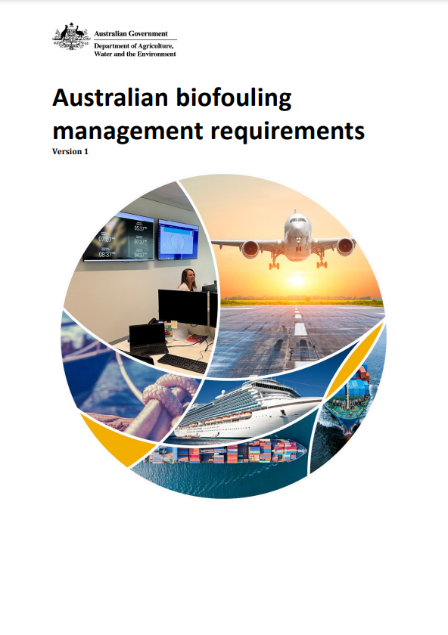
Australia’s biofouling requirements
Mandatory pre-arrival reporting
Accepted management options:
Implemented an effective biofouling management plan and record book; or
Cleaned all biofouling within 30 days prior to arriving in Australian territory; or
Implement an alternative biofouling management method that has been pre-approved by the department.
Notes:
What is mandatory: pre-arrival reporting.
Accepted methods:
Implement an effective BFMP
Clean all fouling within 30 days prior to arriving
Alternative pre-approved method (catch all).
A vessel does not have to implement one of these options. It means they’re eligible for lower intervention.

Slide 4
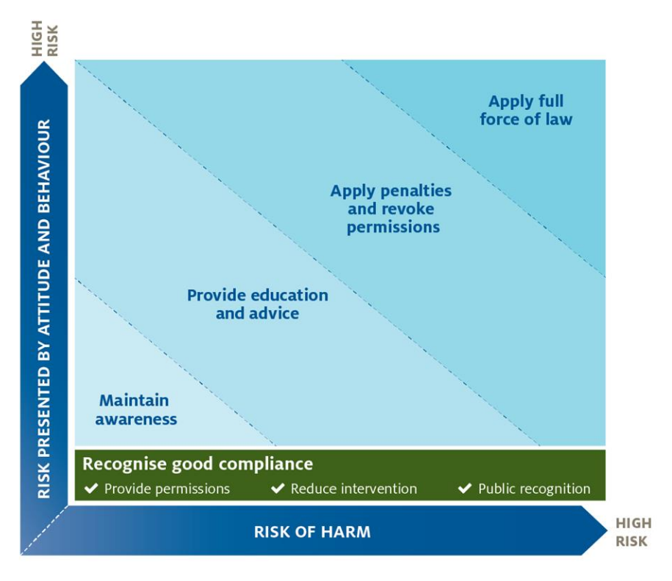
Enforcement ready
DAFF proportionate compliance response model
Department
Systems and personnel enforcement ready
Education material
Vessels
Education and engagement
DAFF Compliance Policy
YES accepted management option
low intervention
Must be able to demonstrate through evidence upon request
NO accepted management practice
flagged for risk assessment by inspector

Slide 5
Education and engagement
Publish
Rebuild department biofouling and in-water cleaning webpages
Australian Biofouling Management Requirements Version 2
Biofouling management plans and record books
Simplified guidance related to IMO Biofouling Guidelines
Niche area focus
Template (optional)
Antifouling Guidelines and In-water Cleaning Standards

