Slide 1




GAC UK
Discover our world of logistics services

Slide 2
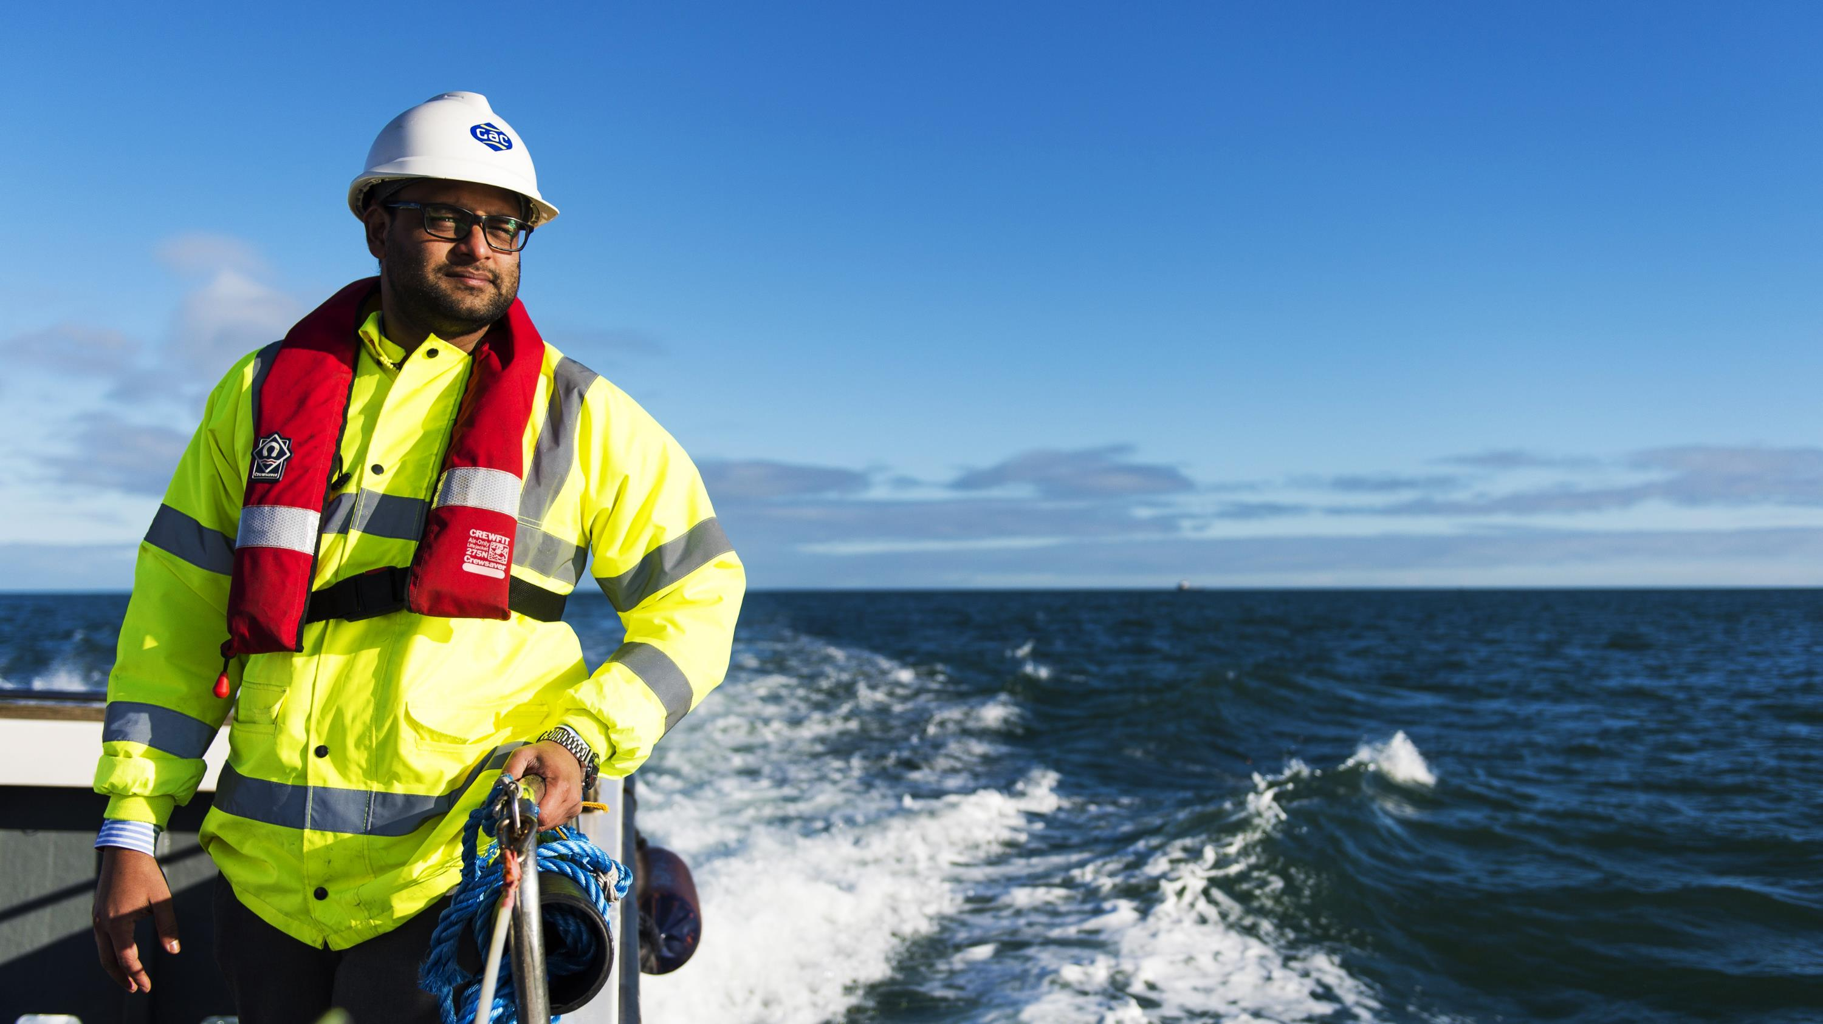

Menu
Home
This is GAC
Logistics Services
Energy Logistics
Customs Services
Time Critical Services
Project Logistics
Global Sports Events Services
Added Value Services
Compliance & Ethics
Sustainable Practices
Contact
This is GAC
Shipping | Logistics | Marine
GAC provides world-class ship agency, logistics and marine services to customers worldwide. Emphasising a long-term approach, innovation, ethics and a strong human touch, our people work hard to deliver excellence in everything we do.
20+
locations in UK, Ireland & Gibraltar
300+
global offices
50+
countries
7500+
dedicated people
We draw on our deep practical experience and expertise to offer integrated services to the energy and shipping industries across the United Kingdom, Ireland and Gibraltar. We also meet the needs of specialised sectors such as automotive, aviation, marine leisure, sports and events.

Slide 3





Menu
Trusted, global expertise
Home
This is GAC
Logistics Services
Energy Logistics
Customs Services
Time Critical Services
Project Logistics
Global Sports Events Services
Added Value Services
Compliance & Ethics
Sustainable Practices
Contact
Logistics Services
Road freight
Ocean freight
Air freight
Couriers
Ocean
Rail freight
We work with our own fleet of general cargo and specialized trucks, lorries and carriers at many locations round the world – look out for the distinctive GAC logo and lively. And where we do not have our own vehicles, we work with carefully checked and monitored partners who meet GAC’s high standards.
Safety and security are paramount. All land transport services GAC provides – either using our own fleet and drivers or those of trusted partners – must meet the highest standards set out in the GAC Group’s HSSE Policy.
Our contracts with many of the world’s leading ocean carriers covering key trades to/from Asia, USA, Middle East, Europe and Africa enable us to offer the best deals for your cargoes.
Your cargo can be loaded into containers for shipment, either as FCL (Full Container Loads) or LCL (Less than Container Loads) for secure delivery.
Our consolidation services offer an economical option for smaller loads.
Our global air freight services deliver cargo to every location around the world served by an airport.
Our global partnerships with major air carriers give you priority access to competitive rates and space allocations.
Choose from door-to-door, customs cleared deliveries, consolidated freight options and charter services for bespoke solutions.
We provide international courier solutions globally.
Working with all the major fast parcel carriers, choose from competitive rates and a range of delivery timeframes to suit your requirements.
We provide comprehensive logistics services by land, sea and air.
With a team of 100+ dedicated logistics and customs experts you can rely on GAC UK for trusted, quality support around-the-clock.
We can take your cargo off the road and onto the rail whenever timelines allow. This will reduce your scope 3 carbon emissions.
What’s more, we will provide the data to back up so you can compare freight timelines and price along side its potential impact on the planet.
Rail
Road
Air
+AEO accredited customs team
Couriers
Notes:
9

Slide 4
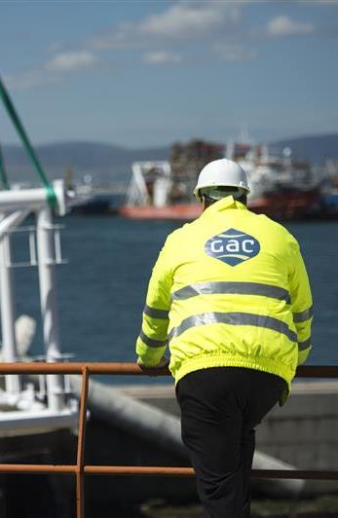










Menu
Seamless, single source services
Home
This is GAC
Logistics Services
Energy Logistics
Customs Services
Time Critical Services
Project Logistics
Global Sports Events Services
Added Value Services
Compliance & Ethics
Sustainable Practices
Contact
Energy Logistics
With offices strategically positioned at key energy hubs across the UK, GAC provides specialist support services tailored to the demands of the energy sector. Our experienced team understands the complexities of energy operations and is committed to delivering efficient, high-quality solutions.
Freight forwarding & customs services
Warehouse solutions
GAC Aberdeen
GAC Great Yarmouth
GAC Aberdeen
Strategically located to support the energy industry across the Southern North Sea sector, our facility is just 3 miles from major shore bases, enabling us to provide around the clock support.
Located 10 min from Aberdeen Harbour & 20 min from Aberdeen Airport, GAC Aberdeen provides our energy customers with 3 PL, time-critical, ship spares logistics, customs services & warehousing solutions.
Global control tower support
Project
logistics
OUR STRATEGIC LOCATIONS
Procurement services
Quayside/mob coordination
GAC Great Yarmouth
Ship agency & husbandry services
Bunker
fuels
Door-to-deck ship spares delivery

Slide 5



Menu
Experts you can rely on
Home
This is GAC
Logistics Services
Energy Logistics
Customs Services
Time Critical Services
Project Logistics
Global Sports Events Services
Added Value Services
Compliance & Ethics
Sustainable Practices
Contact
Customs Services
Our customs team has 30+ years combined experience in all clearances.
We ensure your consignments clear customs swiftly and efficiently.
We are:
Neutral & independent
An Approved Economic Operator
Experts in all UK customs regimes & transit procedures
Consultants providing bespoke training services
Book a customs health check

Slide 6




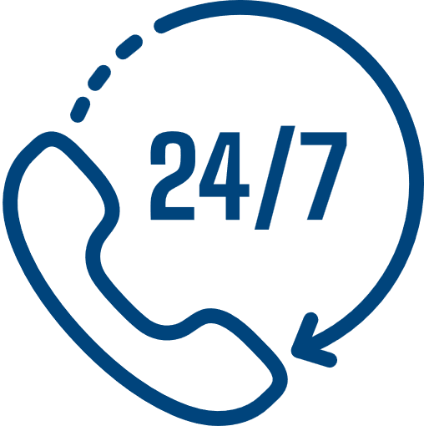

Menu
For when fast is not enough
Home
This is GAC
Logistics Services
Energy Logistics
Customs Services
Time Critical Services
Project Logistics
Global Sports Events Services
Added Value Services
Compliance & Ethics
Sustainable Practices
Contact
Time Critical Services
Time is money and we help you save with single source deliveries of time-critical cargoes.
Our Time Critical Services are available around-the clock, supporting in the following areas:
Aircraft on Ground (AOG)
Aircraft & helicopter chartering
Ships spares, automotive & pharmaceutical
Contact the Time Critical Team
Dangerous goods

Slide 7
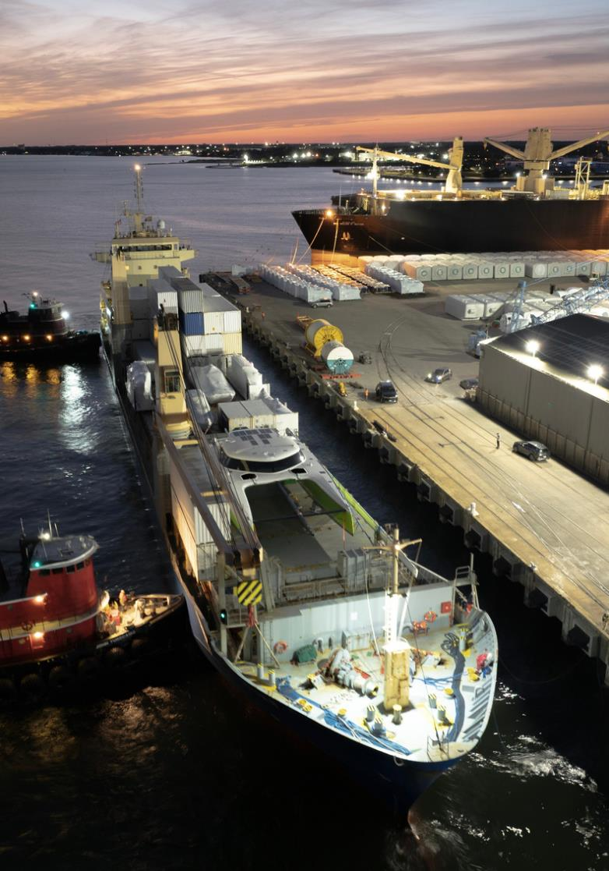









Menu
For any complex transport - think GAC
Home
This is GAC
Logistics Services
Energy Logistics
Customs Services
Time Critical Services
Project Logistics
Global Sports Events Services
Added Value Services
Compliance & Ethics
Sustainable Practices
Contact
Project Logistics
We have extensive experience managing diverse project cargo, providing comprehensive global end-to-end solutions for the energy and niche logistics sectors.
We can handle project moves of any scale and complexity. Working to tight deadlines and with complex size restrictions, we deliver on time, on budget to your preferred location.
Survey & feasibility studies
Load optimisation & CO2 emission reporting
Heavy lift & special equipment transport
Stevedoring, load masters & terminal services
Load optimisation & freight CO2 emission reporting
Full / part vessel / air charter
Forward planning & cargo method statements
Towage & barge operations
Operations supervision & technical consulting
EMAIL US

Slide 8




Menu
Podium position every time
Home
This is GAC
Logistics Services
Energy Logistics
Customs Services
Time Critical Services
Project Logistics
Global Sports Events Services
Added Value Services
Compliance & Ethics
Sustainable Practices
Contact
Global Sports & Events Services
We meet the complex, time-critical logistics demands of events, ensuring every piece of equipment arrives safely, at the right place and at the right time.
We are dedicated to providing the most cost-effective and time-efficient solutions to meet your specific requirements and reach your sustainable goals.
Logistics services
On-ground support
Transportation by road, rail, sea and air
Project cargo & vessel chartering
Customs clearances
Dangerous goods handling
Feasibility planning & budgeting
Timeline management
Event consultancy & site management
Risk assessments
Container rental
Delivery sequencing
Handling equipment rental
Courier delivery management
EMAIL US
Official logistics partner for The Ocean Race for 4 consecutive editions

Slide 9
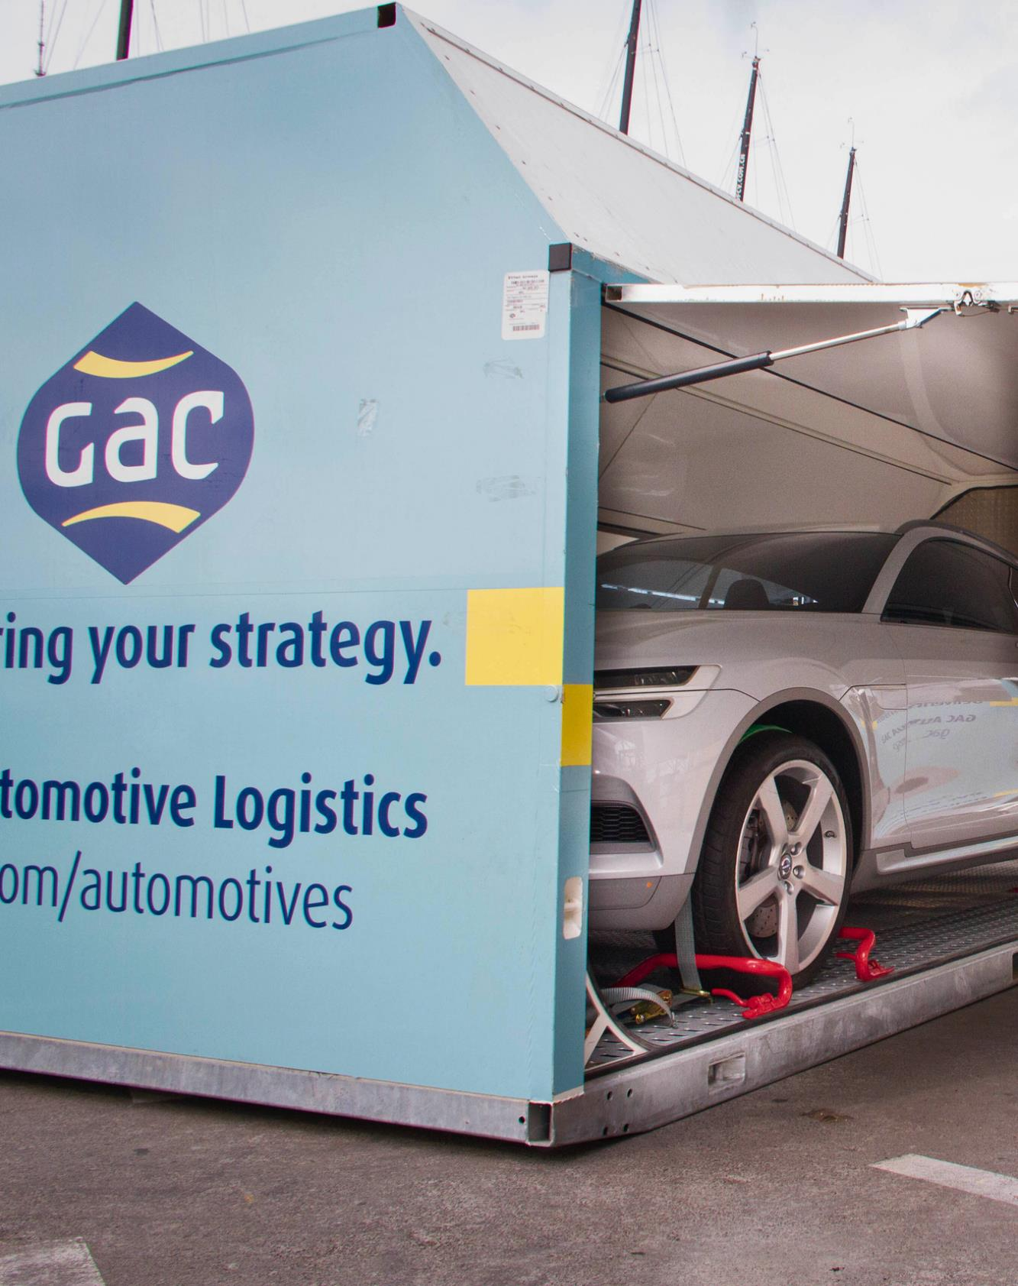




Menu
Adding value everyday
Home
This is GAC
Logistics Services
Energy Logistics
Customs Services
Time Critical Services
Project Logistics
Global Sports Events Services
Added Value Services
Compliance & Ethics
Sustainable Practices
Contact
Additional Services
We believe in flexibility, responding to the needs of our customers and adapting to global circumstances. That’s why we have developed a suite of additional services to keep your cargo moving.
What’s more, our logistics expertise can be applied to niche logistics areas. From automotive to superyachts, choose GAC.
Track and Trace portal
Complementary customs health check for your business
GAC Sure - insurance as you need it
Freight CO₂e emissions portal

Slide 10
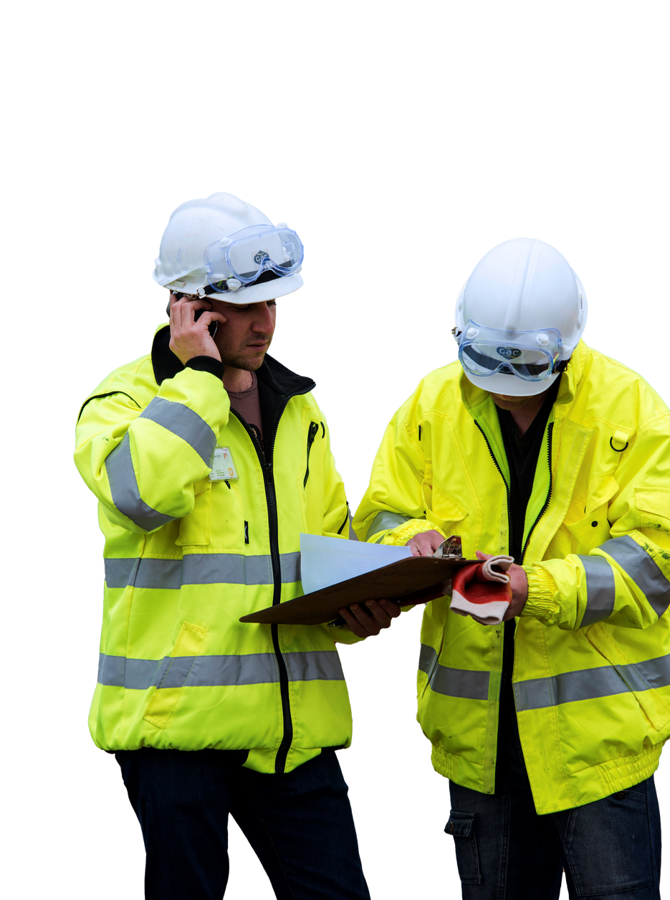




Menu
Strong QHSSE culture
Home
This is GAC
Logistics Services
Energy Logistics
Customs Services
Time Critical Services
Project Logistics
Global Sports Events Services
Added Value Services
Compliance & Ethics
Sustainable Practices
Contact
Compliance & Ethics
We are dedicated to providing the highest levels of quality, safety and compliance in all our services.
Good QHSSE management is essential to the well-being of our employees, their families, customers and all GAC stakeholders.
GAC Code of Ethics
Our Code of Ethics covers how GAC people conduct themselves, it respects the law and ensures we treat customers, suppliers and colleagues honestly, fairly and with dignity.
We are certified
Supplier vetting
Our training
GAC UK is ISO 9001:2015 Quality Management & ISO 14001:2015 Environmental Management certified
Stringent supplier vetting services – over 1,400 approved suppliers
40+ IOSH trained Managers and 16 x Mental Health First Aiders

Slide 11


Menu
For people and planet
Home
This is GAC
Logistics Services
Energy Logistics
Customs Services
Time Critical Services
Project Logistics
Global Sports Events Services
Added Value Services
Compliance & Ethics
Sustainable Practices
Contact
Sustainable Practices
We have a roadmap to decarbonisation, and track our carbon emission impact across Scopes 1, 2 and 3. We are committed to the target of a 30% reduction in Scope 3 emissions by 2030.
Freight CO2 emission reports on quotes & invoices help our customers meet their own reduction targets. Customers using the ‘GAC Portal’ interface can access live, real-time CO2 emissions data for all their shipments.
All packaging materials used in our warehouses are made from recycled materials and are fully recyclable, reusable, or can be repurposed.
GAC UK’s sustainability programme, MARS30 is aligned with the UN Sustainable Development Goals. This ensures we consider People and the Planet in all our undertakings.

Slide 12

GAC UK
Shipping I Logistics I Marine
CONTACT US:
uk@gac.com

